Slide 1
Where the heart is
Week 4

Slide 2
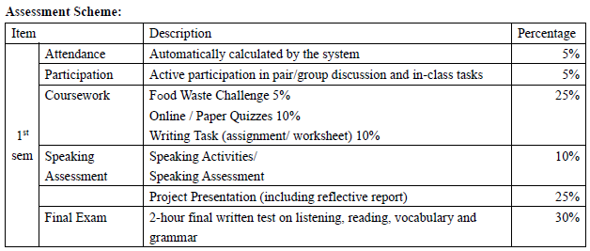
Notes:
https://www.menti.com/al9z4jupmbcx

Slide 3
Past simple
Listen to the news report about living in Vienna, Austria. Choose the correct words to complete the sentences.
1. Vienna is one of the world's most pleasant / expensive cities.
2. The boy lives in a modern / historic area near the city centre.
3. He says that people in New York pay more / less to go out with friends.
4. The girl says that the underground is / restaurants are open 24 hours.
5. She lives / works in the suburbs.
6. She says the suburbs are / aren’t boring.

Slide 4
Past simple
Work in pairs. Answer the questions from the news report about Vienna. Listen again to check your answers.
When did the boy's family move to Vienna?
Why did they move to Vienna?
Where did they stay when they first arrived?
Why did the girl's family move to the suburbs?
They moved to Vienna two years ago.
They moved to Vienna because of his mum's job.
They stayed in a hotel.
They moved to the suburbs because of her dad's job.

Slide 5
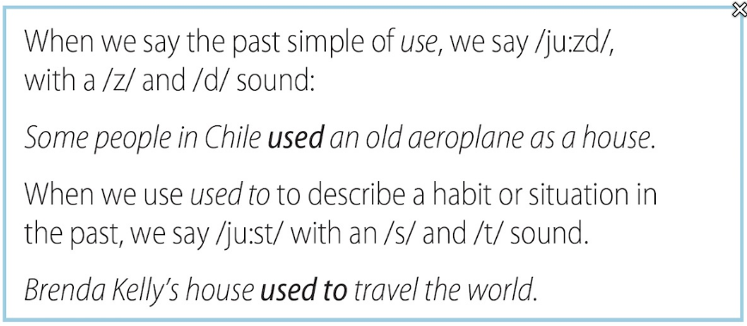
Pronunciation /zd/ and /st/ in used
a. Look at the pronunciation box and listen to the examples.

Slide 6
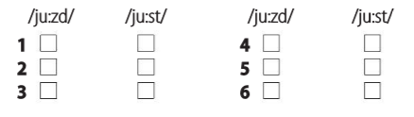
Pronunciation /zd/ and /st/ in used
b. Listen to the sentences and choose the sound you hear.
1. I used to live in a normal house, but now I live in a shipping container.
4. People used to throw away old bottles, but now we recycle them.
2. Some people in Mexico used shipping containers to build a school.
5. Some people in Brazil used shipping containers to make an art gallery.
3. One man in Canada used old bottles to build a house.
6. Of course, everything that’s made of wood used to be a tree.

Slide 7
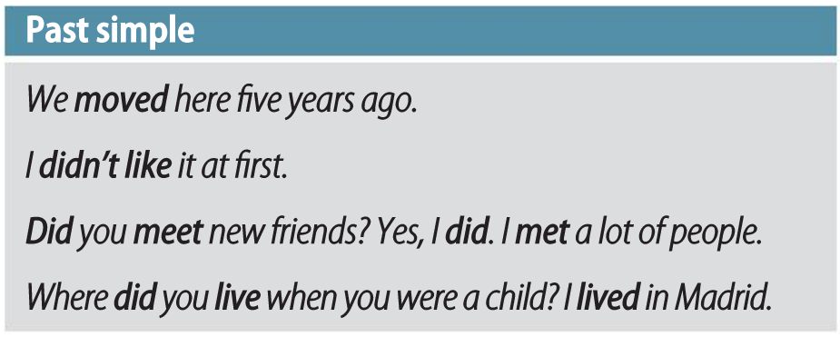
Past simple

Slide 8
Past simple
Look at the Grammar box. Match the two parts of the sentences to make rules about the past simple. (Two sentences have the same ending.)
we use the past form of do and the infinitive.
actions completed before now.
the verb shows the past tense.
1. For affirmative statements about the past,
2. For negative statements about the past,
3. For questions about the past,
4. We use the past simple to talk about
c
a
a
b

Slide 9
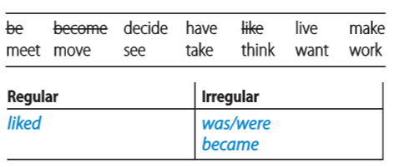
Past simple
We add -(e)d to the infinitive to make the past simple of regular verbs, but many common verbs are irregular. Write the past simple form of these verbs and say whether they are regular or irregular.
decided
lived
moved
had
made
met
wanted
worked
saw
took
thought

Slide 10

Past simple
Complete the sentences with some of the verbs from Exercise 9.
1. When I was twelve, my family to Hong Kong.
2. At first, my brother and I it was a wonderful place to live – so busy and lively.
3. We in an apartment near the business district, and we a lot of new people.
4. But our father and mother both very hard in their new jobs and they were never at home.
5. We soon bored with our life there and to move back home.
moved
thought
lived
met
worked
became
wanted

Slide 11
Past simple
Use the past simple to complete the article about an interesting living situation.
When did Brenda Kelly (1) (become) interested in very small houses? When she was just thirteen years old. She (2) (draw) plans and pictures and (3) (dream) of building her own small house.
A few years later, she (4) (be) ready for a house, but she (5) (not have) a lot of money to spend on it. One day, she (6) (see) some shipping containers at a container terminal* and she (7) (think) it would be cool to live in one.
Brenda (8) (not be) sure it was possible to make a house from a container. She did research and found people who (9) (make) houses with materials that used to be something else. It (10) (not take) long for her to find help and start building.
become
drew
dreamed
was
didn’t have
saw
thought
wasn’t
made
didn’t take
terminal a dock or port where ships load and offload goods

Slide 12
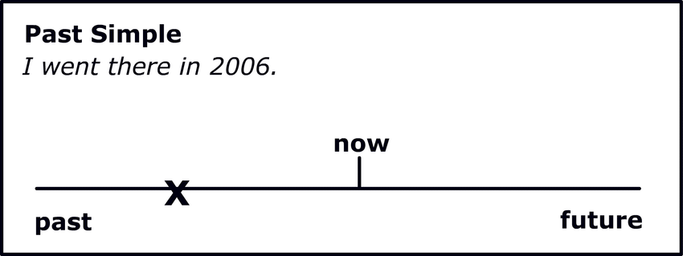
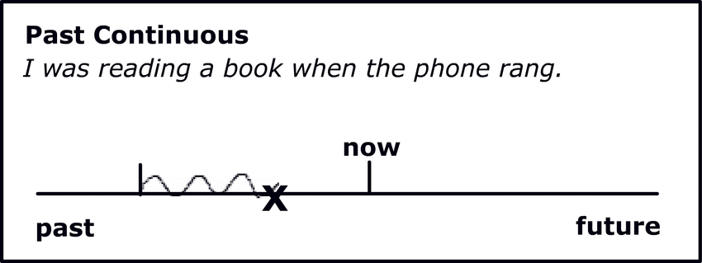
Past continuous
Compared to Past Simple tense, Past continuous describe completed actions or events / general situations in the past.
All of them are formed with the past simple of be / have and a verb in the –ed / -ing form.

Slide 13
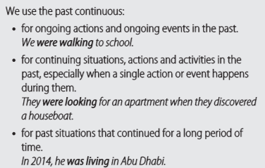
Past continuous

Slide 14
Past continuous
Complete the text with the past simple or past continuous of the verbs in brackets.
When Yinka llori (1) was growing up (grow up), his parents often (2) advised (advise) him to think about becoming an engineer. Instead, when he finished high school, he (3) chose (choose) to study furniture design. Three years after he (4) graduated (graduate), while he (5) was trying (try) to develop his own style, he (6) did (do) a project where he took two old chairs and made them into one new one. He then (7) realized (realize) that his work was about storytelling and different cultures coming together and mixing. He (8) was developing (develop) these ideas when an art expert (9) found (find) his work online and invited him to show it at Milan Design Week – the world's largest design fair.

Slide 15
Past simple and Past continuous
Complete the conversation with the past simple or past continuous of the verbs in brackets.
A: How (1) did your parents find (your parents find) your new apartment?
B: My dad (2) was driving (drive) to work when he (3) saw (see) a man putting up a 'to let' sign. He (4) stopped (stop) the car right away. The man (5) was driving (drive) away, but my dad (6) shouted (shout), 'Hey, wait!', and the man (7) stopped (stop).
A: Was the man surprised?
B: Yes, but then my dad (8) asked (ask) to see the apartment. While he (9) was looking (look) around, he (10) called (call) my mum and (11) told (tell) her to come see it. She (12) loved (love) it, too. So they (13) rented (rent) it!

